Slide 1
Information Literacies
Research Skills
University of South Dakota Library. University of South Dakota, 2013. Web. 01 Oct. 2013.

Slide 2
What is Information Literacy?
Information literacy is the ability to successfully find, retrieve, analyze, and use research or information for an academic purpose.
It is a refined set of research skills that help you find credible and helpful resources.
It can be broken up into 4 categories
Research Skills
Database Skills
Web Evaluation Skills
Academic Integrity Skills

Slide 3

Why practice research skills?
This unit is designed to help you achieve/realize several things.
Where and how to find the best resources for your projects.
Help reduce the anxiety associated with doing research.
Improve research skills and the quality of the sources you find.

Slide 4
Research: getting started
When beginning a research project, it is always helpful to have some kind of strategy before starting that paper writing process. Here are some tips on where to begin.
Start early: By doing so, you will give yourself enough time to collect materials, analyze them, and decipher which resources you will use for your paper. You will also have ample time to shift ideas or re-arrange elements if necessary.
Be organized: Keep a folder of your printed resources. Use highlighters and pens to take notes of important passages.
Research subject: Go in with a general knowledge of your topic and take the time to gather some new information on your subject.
Create a thesis statement or claim: Know what you want to discuss.
Begin looking in the right place for resources: Libraries or library databases.

Slide 5
Periodical Literature
Periodical literature consists of scholarly journals, magazines, and newspapers.
These are articles and entries that have been published and are certified to be up to date and academically acceptable.
AKA: These are legitimate sources that you can use with confidence in your papers. There is no need to worry about a lack of credibility.
The first place to look for periodical literature is the school library page.
Once there, search for articles in one of the several search databases that are listed.
EBSCO
ProQuest
InfoTrac
JSTOR
A-Z List on the South Dakota State Library

Slide 6

Scholarly journals
Scholarly journals are…
Published by colleges, universities, research institutes, and professional organizations.
Peer Reviewed (reviewed by experts and given the “okay” for publication).
Written for specialists (use jargon specific to a field of study – remember the importance of “audience” when writing).
Have abstracts at the beginning (a brief summary of what the article is about).
Very detailed and thorough.
Usually published quarterly.
Have a professional look.

Slide 7
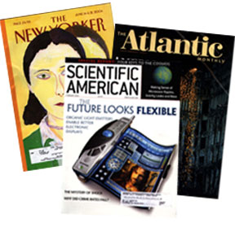
Popular Magazines
Popular Magazines are…
Published by commercial organizations.
Are not peer reviewed.
Contain articles written by journalists for “non-specialists” (articles written in “layman’s terms”).
Contain shorter articles with no abstracts.
Usually published weekly or monthly.
Sometimes have a glossy look.

Slide 8

Newspapers
Newspapers are…
Produced by commercial organizations.
Are not peer reviewed.
Contain articles written by journalists for “non-specialists” (articles written in “layman’s terms”).
Contain extensive advertising.
Usually published daily or weekly.
Usually printed in black and white on paper.
Sometimes offered online.

Slide 9
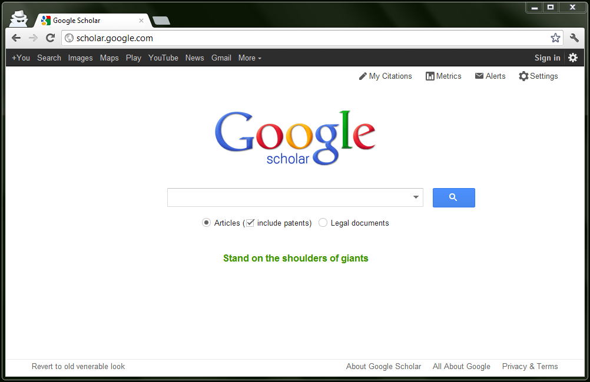
Reliable search engines
Several trustworthy search engines…
www.ipl.org
www.digital-librarian.com
www.infomine.ucr.edu
www.scholar.google.com

Slide 10
Where do you gain access to these databases?
Begin by going to the Southeast Tech website.
http://www.stinet.southeasttech.edu/

